Slide 2
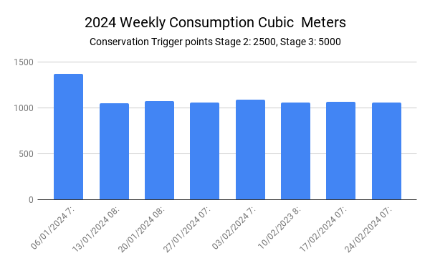

Slide 6
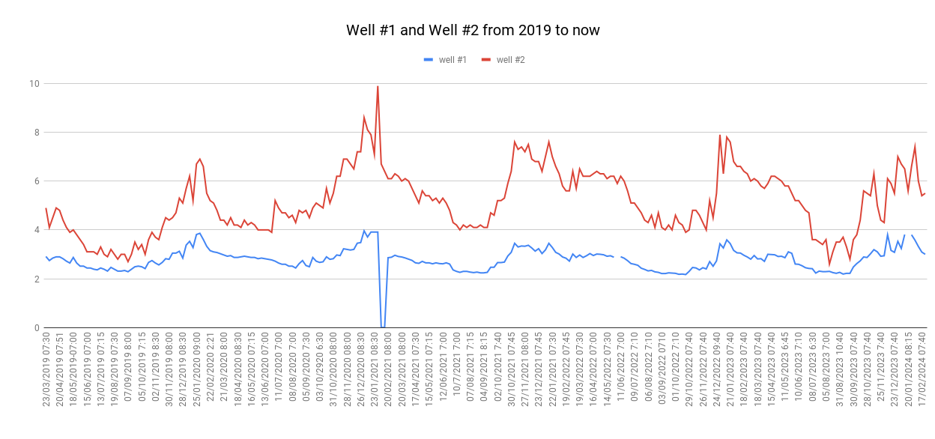

Slide 8
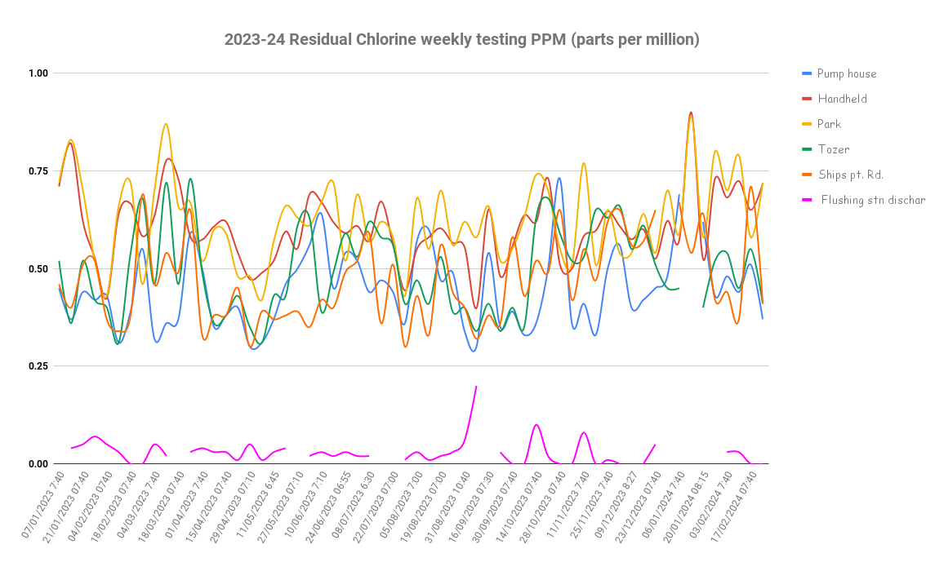

Slide 9
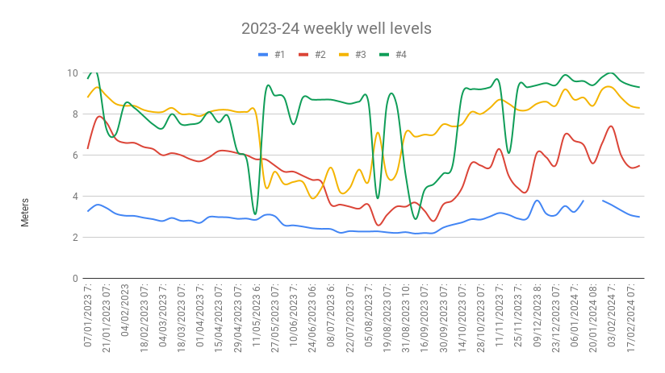

Slide 10
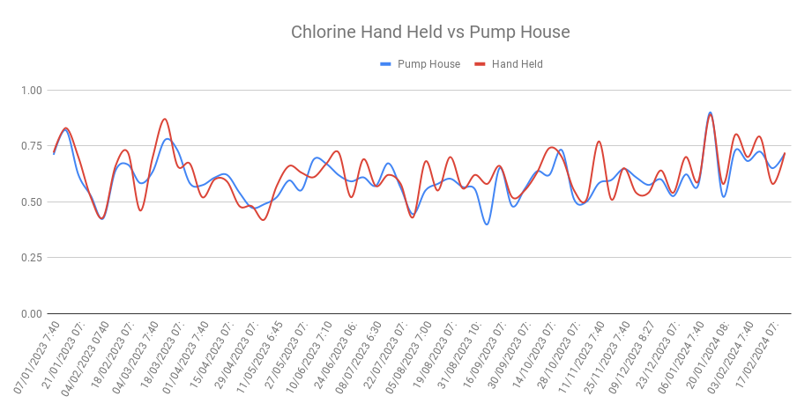

Slide 12
Ships Point Improvement Dist.
Well # 4 Draw down test results before and after well redevelopment
Jan 2nd 2024
 | Out flow | Discharge | Well 4 |  | Notes
Test No. | LPM | PSI | Meters
1 | Static |  | 9.6 | No drawdown as #4 pump not running
2 | 142 |  | 7.9 | consumer demand
3 | 287 |  | 6 | Increase outflow/ demand using hydrant at pump house gate
4 | 376 |  | 4.7
5 | 500 |  | 2.9
6 | 595 |  | 1
7 | 619 |  | < 1 | Low level alarm test stopped
Conclusion: If we had left it at 500 LPM it would have drawn down to an alarm level I think the stable limit would be closer to 400 LPM
30 and 31 Jan 2024 Well #4 Redevelopment performed by Drillwell
Feb 1st 2024
 | Out flow | Discharge | Well 4 |  | Notes
Test No. | LPM | PSI | Meters
1 | Static |  | 10.1 | No draw down
2 | 115 |  | 9.2 | consumer demand
3 | 200 |  | 8.7 | Outflow/Demand increased using Hydrant
4 | 311 |  | 7.8
5 | 420 |  | 7.2
6 | 524 |  | 6.5
7 | 635 |  | 5.6
8 | 744 |  | 4.9
9 | 752 |  | 4.5
10 | 771 | 44 PSI | 4.4 | Well level is good to 1.0m however we are reaching the top end of the pump capacity hence the low discharge pressure
11 | 762 | 43 | 3.8 | Normal discharge pressure is between 80 and 90 PSI
12 | 750 | 70 | 4.5 | Test stopped as low discharge pressure alarm
13 | Static |  | 10 | No draw down (pump off) static of 10m under 2min (estimated)
Conclusion: I feel if the pump was capable we could have very easily reached a outflow of 800 LPM with stable well level at above 2m
This data matches the data from drillwell, doubling the well capacity after redevelopment

